Slide 1
AUTONOMOUS ROBOT
LINE FOLLOWER
MOBILE CONTROLLED ROBOT

Slide 2
CONTENT
Learning DE-10 NANO FPGA
Universal Asynchronous Receiver/Transmitter
Why Receiver ?
UART output block
Mobile app

Slide 3
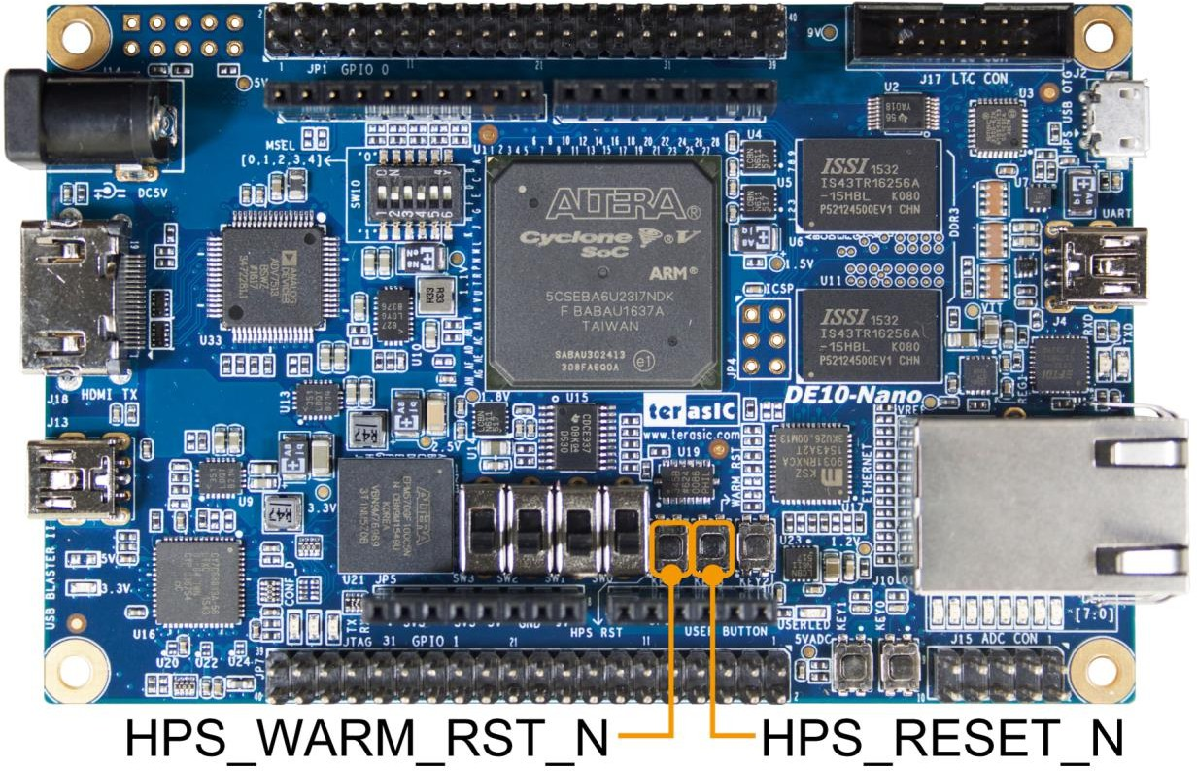
 | GPIO 0 | (JP1) |  |  | GPIO 1 | (JP7)
PIN_V12 GPIO_0[0] | 1 | 2 | GPIO_0[1] PIN_E8 | PIN_Y15 GPIO_1[0] | 1 | 2 | GPIO_1[1] PIN_AC24
PIN_W12 GPIO_0[2] | 3 | 4 | GPIO_0[3] PIN_D11 | PIN_AA15 GPIO_1[2] | 3 | 4 | GPIO_1[3] PIN_AD26
PIN_D8 GPIO_0[4] | 5 | 6 | GPIO_0[5] PIN_AH13 | PIN_AG28 GPIO_1[4] | 5 | 6 | GPIO_1[5] PIN_AF28
PIN_AF7 GPIO_0[6] | 7 | 8 | GPIO_0[7] PIN_AH14 | PIN_AE25 GPIO_1[6] | 7 | 8 | GPIO_1[7] PIN_AF27
PIN_AF4 GPIO_0[8] | 9 | 10 | GPIO_0[9] PIN_AH3 | PIN_AG26 GPIO_1[8] | 9 | 10 | GPIO_1[9] PIN_AH27
5V | 11 | 12 | GND | 5V | 11 | 12 | GND
PIN_AD5 GPIO_0[10] | 13 | 14 | GPIO_0[11] PIN_AG14 | PIN_AG25 GPIO_1[10] | 13 | 14 | GPIO_1[11] PIN_AH26
PIN_AE23 GPIO_0[12] | 15 | 16 | GPIO_0[13] PIN_AE6 | PIN_AH24 GPIO_1[12] | 15 | 16 | GPIO_1[13] PIN_AF25
PIN_AD23 GPIO_0[14] | 17 | 18 | GPIO_0[15] PIN_AE24 | PIN_AG23 GPIO_1[14] | 17 | 18 | GPIO_1[15] PIN_AF23
PIN_D12 GPIO_0[16] | 19 | 20 | GPIO_0[17] PIN_AD20 | PIN_AG24 GPIO_1[16] | 19 | 20 | GPIO_1[17] PIN_AH22
PIN_C12 GPIO_0[18] | 21 | 22 | GPIO_0[19] PIN_AD17 | PIN_AH21 GPIO_1[18] | 21 | 22 | GPIO_1[19] PIN_AG21
PIN_AC23 GPIO_0[20] | 23 | 24 | GPIO_0[21] PIN_AC22 | PIN_AH23 GPIO_1[20] | 23 | 24 | GPIO_1[21] PIN_AA20
PIN_Y19 GPIO_0[22] | 25 | 26 | GPIO_0[23] PIN_AB23 | PIN_AF22 GPIO_1[22] | 25 | 26 | GPIO_1[23] PIN_AE22
PIN_AA19 GPIO_0[24] | 27 | 28 | GPIO_0[25] PIN_W11 | PIN_AG20 GPIO_1[24] | 27 | 28 | GPIO_1[25] PIN_AF21
3.3V | 29 | 30 | GND | 3.3V | 29 | 30 | GND
PIN_AA18 GPIO_0[26] | 31 | 32 | GPIO_0[27] PIN_W14 | PIN_AG19 GPIO_1[26] | 31 | 32 | GPIO_1[27] PIN_AH19
PIN_Y18 GPIO_0[28] | 33 | 34 | GPIO_0[29] PIN_Y17 | PIN_AG18 GPIO_1[28] | 33 | 34 | GPIO_1[29] PIN_AH18
PIN_AB25 GPIO_0[30] | 35 | 36 | GPIO_0[31] PIN_AB26 | PIN_AF18 GPIO_1[30] | 35 | 36 | GPIO_1[31] PIN_AF20
PIN_Y11 GPIO_0[32] | 37 | 38 | GPIO_0[33] PIN_AA26 | PIN_AG15 GPIO_1[32] | 37 | 38 | GPIO_1[33] PIN_AE20
PIN_AA13 GPIO_0[34] | 39 | 40 | GPIO_0[35] PIN_AA11 | PIN_AE19 GPIO_1[34] | 39 | 40 | GPIO_1[35] PIN_AE17

Slide 4
FPGA Design Flow
Design Requirements
Behavioral Simulation
Design Synthesis
Functional (RTL)
Simulation
Design
Implementation
Back annotation
(if needed)
Static Timing Analysis
Generate Bit Stream File
Upload on FPGA BOARD
In Circuit Verification

Slide 5

Protocol
Each character is sent as
a logic low start bit
a configurable number of data bits (usually 7 or 8, sometimes 5)
an optional parity bit
one or more logic high stop bits
with a particular bit timing (“baud”)

Slide 6
Why Receiver
First we write the transmitter code and see the how the data is transmitted but by using transmitter code we don’t get the output.
After 3 or 4 trails of transmitter code,we write the receiver code then after we get the output using the receiver code.
What we understand is by making the connection between and mobile and Bluetooth by mobile app sending bits to the Bluetooth, Bluetooth sends the bits to the board serially so board receives the bits so thats why we need only receiver.
Pin named as Rx in code
Tx
Bluettooth
Rx
Pin
Board

Slide 7
Receiver Code
Receiver module
State machine
Next step Decision
Enable Rd or wr
Read the Input Data
Output assign
To set the state in state machine block idle and next state based on clk and reset.
In the block whether it has to read state or idle based on state ,rx,rxen and rxdone.
In this block whether it has to read or not based on State and rxdone.
In this block the input data is read based on Posedge Tick pulses.
In this block the output data is assigned based on Posedge clock pulses.

Slide 8
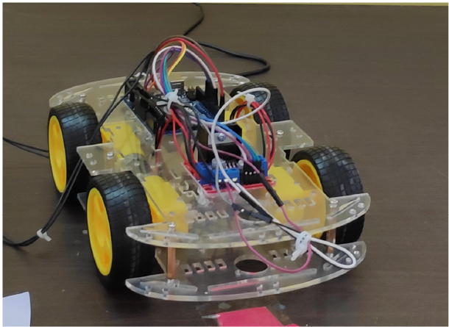
Output Block
Case({Rx_data})
8’b0100:r_data<=({m,n,n,n}); //Right m=High
8’b0110:r_data<=({n,n,m,n}); //Left n=Low
8’b0010:r_data<=({m,n,m,n}); //Front
8’b0101:r_data<=({m,n,n,m}); //Back
8’b0001:r_data<=({n,n,n,n}); //stop
Default:8’b0100:r_data<=({m,n,m,n});
//Front
endcase

Slide 9
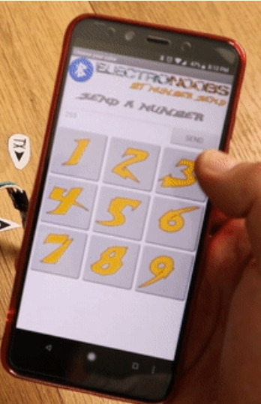
Mobile app
In normal we see the apps for Bluetooth control car in that apps we have only directions like left,right,front,back.
But we designed a app that will send the bits to the Bluetooth directly we give the value to Bluetooth by using this app.
We make this app by using the MIT app
inventor.

